Slide 1
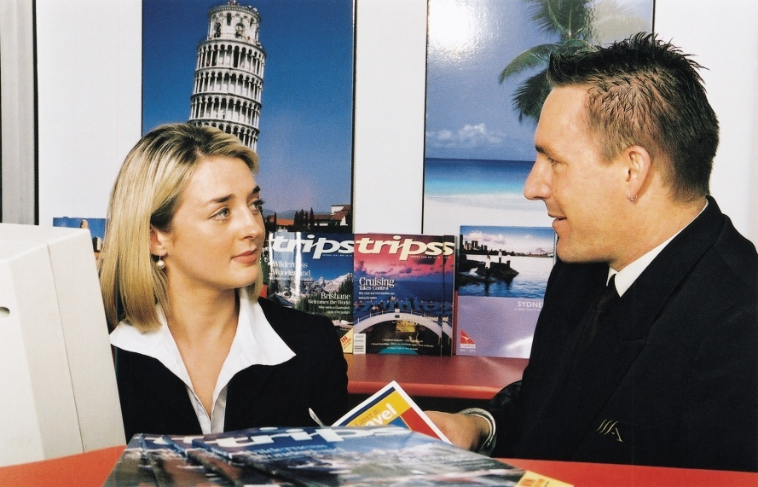
DEVELOP AND UP-DATE LOCAL KNOWLEDGE
Unit Code: D1.HRS.CL1.06 D1.HOT.CL1.09 D2.TTA.CL2.11
Notes:
Trainer welcomes trainees to class.

Slide 2
Develop and update local knowledge
This unit comprises three Elements:
Develop local knowledge
Update local knowledge
Maintain contact with local communities.
Notes:
Trainer advises trainees this Unit comprises three Elements, as listed on the slide explaining:
• Each Element comprises a number of Performance Criteria which will be identified throughout the class and explained in detail
• Trainees can obtain more detail from their Trainee Manual
• At times the course presents advice and information about reporting procedures but where their workplace requirements differ to what is presented, the workplace practices and standards must be observed.

Slide 3

Assessment
Assessment for this unit may include:
Oral questions
Written questions
Work projects
Workplace observation of practical skills
Practical exercises
Formal report from employer/supervisor.
Notes:
Trainer advises trainees that assessment for this Unit may take several forms all of which are aimed at verifying they have achieved competency for the Unit as required.
Trainer indicates to trainees the methods of assessment that will be applied to them for this Unit.

Slide 4

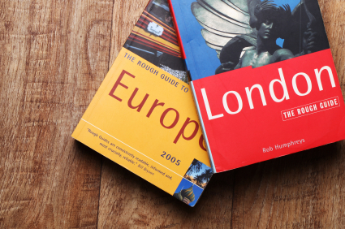
Develop local knowledge
Performance Criteria for this Element are:
Identify and access sources for information on the local area, correctly
Identify and obtain information to correctly answer queries on local/national tourism industry
Store and update information according to enterprise procedures
Share information with colleagues.
Notes:
Trainer identifies for trainees the Performance Criteria for this Element, as listed on the slide.
Class Activity – General discussion
Trainer leads a general class discussion on the development of local knowledge for workers in the hospitality and tourism industries asking questions such as:
Why is there a need for workers to have local knowledge?
How might staff use local knowledge in their day to day work?
What aspects of the local area might workers need to develop local knowledge about?
What sources of local knowledge can you identify?
What personal experiences do you have of providing local knowledge to visitors/tourists?
Have you ever been in a foreign country or different region and wanted some local information but were unable to get it? How did that make you feel? What is your opinion of that place now?

Slide 5
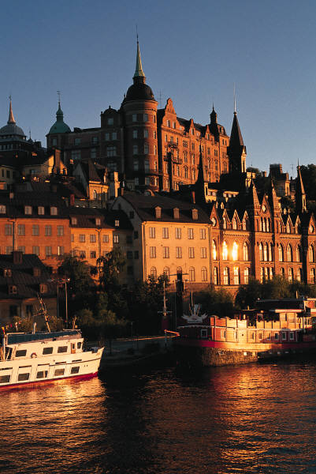
Identify and access sources for information on local area
Local knowledge can include knowledge/information relating to:
Your workplace
Your town or city
Your region
Your country.
Notes:
Trainer instructs trainees that industry and product knowledge are vital pre-requisites for effective performance within the industry.
Trainer identifies ‘local’ knowledge may include information about:
The venue (trainee workplace) also known as ‘product’ knowledge
The town or city in which they work and where their workplace is located
The region – covering the surrounding area, provinces, municipalities
The country – highlighting the need for ‘all of country’ knowledge when dealing with international visitors.

Slide 6
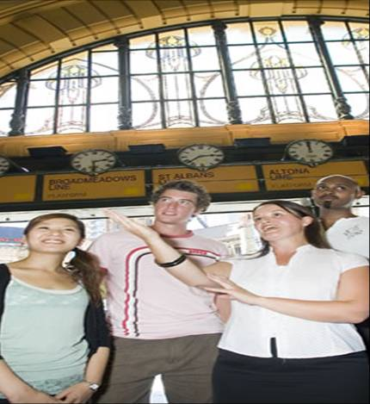
Identify and access sources for information on local area
You must have local knowledge so you can:
Pass this on to tourists/visitors
Inform tourists/visitors about what is happening locally
Meet/exceed visitor/tourist expectations.
Notes:
Trainer explains to trainees it is important to have appropriate and sufficient local knowledge so they can:
Pass this on to tourists/visitors and enhance visitor/tourist experience
Inform tourists/visitors about what is happening locally and convince them to spend more time (and money) in the area or town which will help create more jobs and generate even more tourism, more businesses, more opportunities, and more benefit to the region and the country
Meet tourist and visitor expectation. Tourists/visitors expect staff at a hotel to be able to advise them about local events, attractions .

Slide 7



Identify and access sources for information on local area
Local information should be captured on:
General tourism information
Local tourist destinations, facilities and infrastructure
Tourism products
Environmental issues
Local attractions
Local customs.
Notes:
Trainer explains to trainees when developing local knowledge they should aim to capture information on:
General information on the tourism industry – trends in visitations, country of origin of tourists and in-bound tourist numbers
Local tourism destinations including facilities and infrastructure such as toilets, public transport, emergency services
Tourism products including tourism services, facilities and rates/costs, ticket prices
Environmental issues including eco-tourism, weather, ‘at risk’ species of flora and fauna
Local attractions including local tours, events and places of interest
Local customs – what visitors should do or not do, things they should avoid saying or doing and local food and drinks.
Class Activity – Small Group Exercise
Trainer divides trainees into six groups and asks them to prepare without reference to any outside sources the most comprehensive list of local information they can in relation to each of the six categories listed on the slide (above).
Each group should have a different category, and should be given 30 minutes to generate their list of information.
After 30 minutes the group presents their list to the class who respond by:
Confirming the information provided
Amending or updating the information presented
Adding new information to the list.

Slide 8
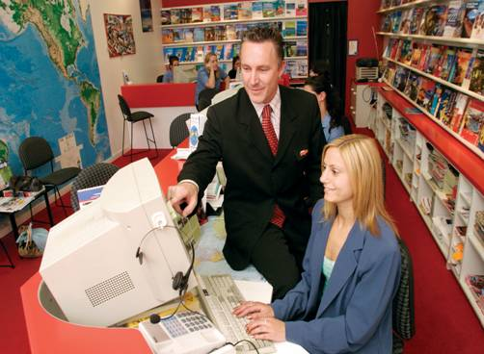
Identify and access sources for information on local area
Useful sources of local information include:
Visitor Information Centres – see next slide
A range of written materials – see later slides
The internet – see later slides
Local associations – see later slides
Networks of personal contacts – see later slides.
Notes:
Trainer advises trainees there are several standard sources that can be used to identify and capture local information, identifying:
Visitor Information Centres
Written materials
The internet
Local associations
Personal network of contacts.
Trainer advises each of the above will be detailed on subsequent slides.

Slide 9
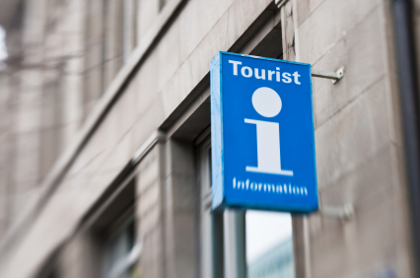
Identify and access sources for information on local area
Visitor Information Centres:
An excellent primary source of information
Materials are already assembled
Visit the Centre to see what is available
Make yourself know to management/operators
Obtain materials (multiple copies) for use/distribution.
Notes:
Trainer tells trainees in respect of Visitor Information Centres:
They are an excellent source of information and should be one of the first places visited to obtain local information. They have already done most of the work in compiling and assembling local information
They must visit the local Centre to see to view the facilities available, the displays on show and obtain a first-hand experience of the ambience and what the Centre has to offer
They need to introduce themselves to management at the Centre or to the staff working in the Centre –in order to create a personal relationship with the Centre, and to facilitate the use of the Centre for obtaining materials and local knowledge
Take multiple copies of the materials (brochures, flyers, maps ) for distribution to other staff, and to give to tourists/visitors.
Class Activity – Excursion
Trainer arranges a visit to the local Visitor Information Centre to:
View facilities
Obtain sample materials
Establish a contact person/point
Meet and talk to staff about:
Important local dates, celebrations, festivals, events
How to promote the local area
How to source local information
Benefits of providing visitors/tourists with local information
How venues can obtain copies of materials promoting local information and how they can identify when existing materials are updated and need to be replaced.

Slide 10
Identify and access sources for information on local area
Written material may include:
Reference books
Trade magazines
Guidebooks
Newspapers
Telephone book
(Continued)
Notes:
Trainer explains to trainees that written materials useful in capturing local knowledge/information can include:
Reference books on the country, region or specific aspects of the country (such as its flora and fauna, its history and customs, famous people, trade details, plans for the area/country)
Trade magazines which may be purchased from newsagents or obtained via subscription. These detail events within the industry and are an excellent source of local, national and global information. Trade magazines can focus on sectors of the industry (such as food and beverage, housekeeping, bars, MICE, spas) and/or provide generic information on, for example, travel, tourism or hospitality
Guidebooks. Numerous guidebooks exist on every major tourist destination/country. While these are often read by tourists to help them obtain a ‘feel’ for the country they are visiting, they can also be useful to staff working in those countries as a reference and resource
Newspapers. Many large circulation newspapers feature some aspect of the travel, tourism and hospitality industries on a regular/weekly basis. These features can include:
Food and drink reviews of restaurants, dining rooms, certain dishes, nominated cuisines, bars, drink types, wines
Industry movements identifying staff who are moving between properties, ownership of venues and the companies buying and selling properties, new properties coming into the marketplace, venues undergoing renovations and refurbishment and venues closing their doors
Travel articles describing travel experiences of correspondents, travel destinations and tourist attractions, explaining how to travel between destinations and differentiating between travel and transportation options
Issues of interest. These may include coverage of a wide range of topics impacting on the industry such as taxation, impact of events locally and internationally, effect of currency fluctuations on inbound and outbound tourists/visitors, industry trends and new products and services.
The local telephone book. Where ‘display adverts’ are used the local telephone book can provide much valuable information about local businesses and local competitors (such as products, facilities and services available, star rating, location relative to other attractions, credit cards accepted, affiliations with clubs, groups or other organisations ).
Class Activity – Internet Research
Trainer arranges for trainees to have internet access and asks them to visit websites of trade magazines and note any magazines, articles, links of interest.
Trainer suggests trainees visit the following:
http://www.media-directory.asia/magazine/business-magazines/hotel-hospitality-business/singapore/c-1874
http://www.traveldailyasia.com/LocalNews/Singapore.aspx
http://hotelresource.tradepub.com/
http://www.travelandleisure.com/
http://ehotelier.com/directory/?magazines-books
Trainer also adds any sites for magazines relevant to their country and/or industry or industry sector.
Class Activity – Text-based materials
Trainer assembles a range of relevant text-based materials for trainees to view and gain an appreciation of in relation to the development of ‘local knowledge’.
The text-based materials must include:
Reference books relevant to the country/area
Guidebooks such as Lonely Planet or similar
A range of local newspapers with an emphasis on sections and/or articles focusing on local events
Local telephone book.

Slide 11
Identify and access sources for information on local area
Libraries
Brochures and flyers
General advertisements.
Notes:
Trainer continues to provide trainees with information about written materials that can be used to develop local knowledge:
Libraries. Where there is access to public libraries they are a great source of material as it is free. It is important to visit the local library to see what is available. They can often arrange inter-library loans too.
Brochures and flyers. Most suppliers and service support industries (local council, authorities, competitors) provide various forms of printed information that can assist with information in relation to:
Product information detailing, for example, the products available at a shop, venue, attraction, destination
Services provided at the location to which the brochure applies
Contact details for their business to which the brochure applies. This includes the telephone number, street address, web details and other information including hours of operation, credit cards accepted
Maps of the local district.
Advertisements whether in the newspaper or in other formats (brochures, flyers, guide books). These are an excellent source of information about other venues in the industry, new products and services, prices, special deals and offers.
Class Activity – Guest Speaker
Trainer arranges for representative from the local library to attend and inform trainees regarding:
Books (videos, DVDs) available at the library that will assist with developing local knowledge
How to register to obtain loans of books and other materials
Terms of use of library materials
Using inter-library loans.
Class Activity – Discussion on Brochures and Flyers
Trainer obtains a wide range of brochures and flyers advertising local events, venues and:
Distributes them for trainees to read
Leads a discussion focusing on:
Identifying a comprehensive list of local events, attractions, festivals
Identifying relevant dates, times, seasons for events
Identifying costs/prices for entry, tickets, accommodation
Discussing how accurate the advertisements/brochures are in relation to trainee personal experience with the venue or attraction
Discussing when it may be appropriate to distribute each brochure of flyer to tourists/visitors.

Slide 12
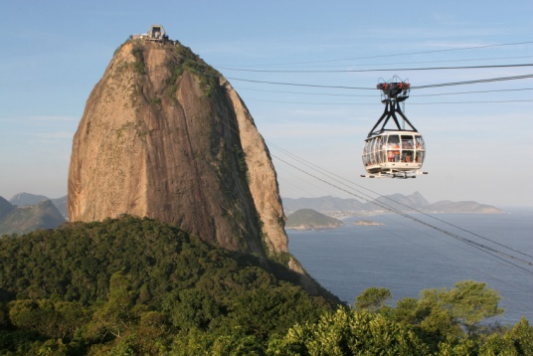
Identify and access sources for information on local area
‘Bookmark’ relevant sites for your area in relation to:
Tour and travel operators
Shops and shopping precincts
Suppliers
Industry associations
Government bodies
Venues
Attractions.
Notes:
Trainer introduces to trainees the online options for gathering local information explaining the extent to which such information is available can vary widely depending on the region, the business and attractions in the area and the degree to which infrastructure exists to support the technology.
Trainer suggests trainees undertake internet research and ‘Bookmark’ relevant sites to facilitate future visits/research on that site, suggesting research should be done regarding:
Tour and travel operators especially those who provide local one-day or half-day tours such as bus trips, self-drive, small groups
Shops for which the local area is famous. For example, some destinations are famous for jewellery, some for electronic goods and others for clothing and fashion
Suppliers – food, beverages, other supplies, equipment
Industry associations such as industry representative bodies and groups, and peak industry bodies
Government bodies such as liquor, gaming, food safety, occupational health and safety, and tobacco agencies
Venues. These should be properties similar to the workplace to enable comparisons with what similar venues do.
Attractions – the natural and man-made attractions in the local area.
Classroom Activity – Internet research
Trainer arranges for trainees to have internet access and asks them to:
Research their local area in relation to the categories presented on the slide
Obtain downloads and hard copies of relevant information
Create a list of useful and important websites for sharing and future reference
Register to receive relevant newsletters and E-mags.

Slide 13

Identify and access sources for information on local area
When using the ‘Net’ to capture local knowledge, be alert to opportunities to:
Register to receive ‘Newsletters’
Register to receive ‘alerts’ and ‘updates’
Identify useful links to other relevant websites.
Notes:
Trainer advises trainees that when using the Internet to develop their local knowledge they should be alert to the potential to:
Register to receive regular or free newsletters, updates and alerts from relevant websites to assist in the development and updating of local knowledge and information
Identify other web pages that may be useful depending on the type of venue and region the trainees are working in.
Classroom Activity – Internet Exercise
Trainer arranges for trainees to have internet access and asks trainees to:
Visit and report back on relevant online newsletters as identified by the trainer for the country in which they are teaching
Visit and register for newsletters at:
http://www.thetravelmagazine.net/cy-4-86--east-southeast-asia--singapore.html
https://app.stb.gov.sg/asp/index.asp
http://www.filipinotravel.com.ph/corporate/newsletter.php
http://www.traveldojo.com/brunei/
http://www.indochinatravelservice.com/newsletter/.

Slide 14
Identify and access sources for information on local area
Local associations are useful as they:
Provide local contacts
Supply information about local businesses
Bring local businesses together.
Notes:
Trainer states that many regions and towns have established a ‘tourism’ association and/or local Chamber of Commerce or similar, identifying that these can be invaluable in terms of:
Providing contacts to use when developing individual industry network – more on next slide
Supplying information about local businesses and the products and services they provide
Bringing local businesses together in a supportive and mutually beneficial environment.
Class Activity – Guest Speaker
Trainer arranges for a representative from a local association/group to visit and talk to trainees about:
The role of the association in the local community
Members of the association
Costs involved in joining and being a member
Benefits they have brought to the local community
Examples of work they have done
When and where they meet
Why tourism businesses should join and be part of the group or association.

Slide 15
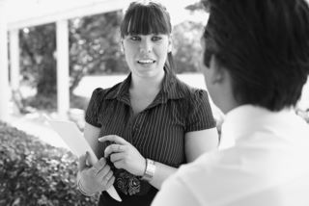
Identify and access sources for information on local area
You should participate in local associations to:
Meet like-minded people
Participate in discussions and planning
Contribute ideas.
Notes:
Trainer tells trainees these associations will meet regularly and it is important for them as representatives of their venue to attend these meetings to:
Meet like-minded people and demonstrate interest in the industry and the local area. These people will also be the start of a network of professional industry contacts (as outlined in following slides)
Participate in discussions which will ultimately have some impact on their workplace, their job and visitors to the area
Contribute ideas which will benefit their venue and the local area or economy.
Classroom Activity – Excursion
Trainer arranges for trainee group to attend as observers at a local association meeting to:
Meet members
Listen to the discussions at meeting
Observe meeting protocols
Gain an insight into the operation of associations of this type
Meet people to include in their network of professional industry contacts.

Slide 16
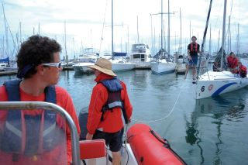
Identify and access sources for information on local area
A network of professional industry contacts is critical. You should develop a network with:
A local tour business or more
One or more opposition businesses or competitors
Manager and staff at the Visitor Information Centre
The local attractions.
Notes:
Trainer explains to trainees that ‘Networking’ is a great way of learning about many industry-related topics. To develop a useful network of contacts they will need to make deliberate attempts to target and talk to people they respect within targeted aspects of the industry they work in.
Trainer suggests they start creating a network of contacts as soon as possible, including relationships (networks) with:
Someone from one or more local tour business to enable identification of what is available regarding local tours e.g. new tours, changes to existing tours, new or different inclusions and prices
A person in an opposition venue in town to allow sharing concerns and information, and to learn from each other. Even though the business may be in direct competition with another venue, it is nonetheless advantageous to develop a good working relationship with the opposition.
The manager of the Visitor Information Centre in order to take advantage of the many tourism materials they have to offer
Staff at local attractions to maintain currency of knowledge about what they have available, new items and inclusions, operating times, prices for entry, rides and package deals
Local associations – as identified on previous slide.
Class Activity – Group Discussion
Trainer leads discussion asking trainees questions such as:
Who might you include in your industry network of contacts?
Why would you include these people?
How would you go about establishing the contact?

Slide 17
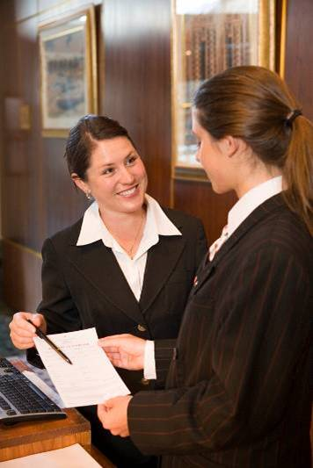
Identify and access sources for information on local area
Once a network contact has been established, it needs to be maintained:
Inform them whenever you have something of interest to them to pass on
Make regular contact with them even when you have nothing specific to say
Meet face to face whenever possible
Thank them for anything they give you.
Notes:
Trainer emphasises to trainees they have to make the effort to create and maintain their network. They cannot rely on others contacting them and initiating the contact.
Trainer also highlights that, after they have made initial contact with these people, they must keep in contact with them:
They need to contact their network when they find out something they think their network might like to know. This highlights the two-way nature of the concept of networking
They need to occasionally contact them just to ‘stay in touch’ even when there is nothing specific to pass on to them. Often they remember something they need to say when contact is made with them and a call to them demonstrates the value placed on them as a network member.

Slide 18
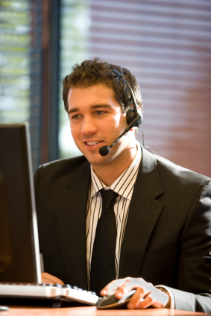
Identify and obtain information to assist with local and national queries
Obtaining local information means applying yourself to the sources already identified, for example:
Subscribing to and reading material
Reading local newspapers and reading books
Calling in to the Visitor Information Centre
Surfing the internet
Joining local groups and associations
Being a tourist in your own area.
Notes:
Trainer reinforces to trainees the need for them to be proactive in capturing necessary local or national information to assist visitors.
Trainer informs trainees obtaining the information they need is a matter of applying themselves to the sources identified previously, which in practice can mean:
Subscribing to, and reading, industry magazines, newsletters, updates, fact sheets, reports, research findings
Reading through local and city newspapers especially those sections carrying articles and features on hospitality, travel and tourism, events, festivals, attractions
Visiting the Visitor Information Centre and meeting the manager/staff and collecting brochures and advertising material. Obtain multiple copies of brochures to place them in display area (at reception, concierge, the foyer area) so they can be given to visitors and guests.
Surfing the internet:
Viewing websites/pages
Downloading, saving, bookmaking or printing relevant information and sites
Registering on e-mail lists to receive newsletters and updates from relevant industry government agencies, suppliers and/or support services
Downloading E-Mags relevant to industry sector. Many of these are free-of-charge but some require payment
Joining your local industry association and taking an active interest in the issues foremost in their minds by participating in discussions, meetings, research
Reading books. Aim to read widely and include local, regional and national books
Being a tourist in the local area. This involves getting out and having a look around to see what is happening, what people are doing, what the competition is doing, and what people are saying.
Class Activity – Major Excursion
Trainer arranges for trainees to be a tourist in their own area and:
Visit local tourist attractions, landmarks and places of interest as if they were a tourist/visitor to the area
Take notes of local information they obtain
Capture brochures, printed advertising and other relevant materials (price lists, schedules)
Talk to operators to grow their network of contacts
Experience as many local tourist attractions as possible to gain first-hand knowledge and experience to serve as the basis for providing local information to visitors.

Slide 19

Identify and obtain information to assist with local/national queries
Obtain information on general tourism industry topics:
Numbers of in-bound tourists
Reasons for travel to the country/area
Amount they spend
Countries of origin
Popular travel times
Methods of travel.
Notes:
Trainer advises trainees when identifying and obtaining information, effort must be taken to capture knowledge about the following ‘general industry information’ topics:
Numbers of inbound tourists and any trends (such as, for example, whether numbers are increasing or decreasing and to what extent)
Reasons for their visits – business, visiting relatives, tourism
Amount spent on a per head and per night basis
Countries of origin determining the 10 most popular countries from which overseas visitors/tourists come
Most popular times of the year for travel highlighting festivals, religious events, holiday periods, seasonal influences
Method of travel identifying the percentages who travel by air, road, train, sea to come to the country.

Slide 20
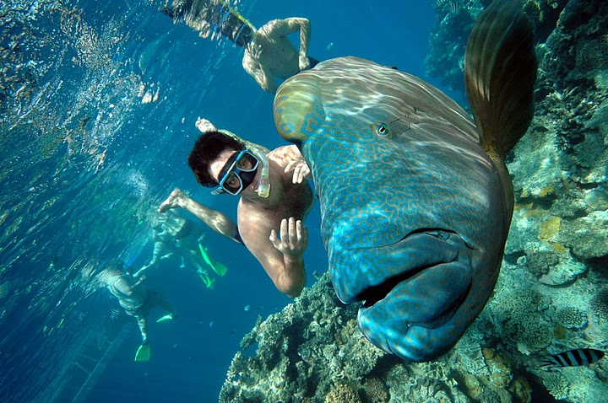
Identify and obtain information to assist with local/national queries
In relation to local destinations, facilities and infrastructure obtain information including:
Identification of local tourist destinations – man-made and natural
Identification of local facilities for tourists/visitors
Identification of local infrastructure visitors may want to use.
Notes:
Trainer recommends to trainees that in relation to local destinations, facilities and infrastructure they obtain information including:
Identification of local tourism destinations such as towns, villages, lakes, rivers tourists could be expected to visit. Within these destinations there may be ‘attractions’ (discussed on later slides). For local destinations they need to determine:
Route to the destination including options, where applicable
Distance
Opening hours
Cost, if any, to visit
Identification of local facilities for tourists such as toilets, medical facilities, hospitals, baby changing facilities, disabled facilities, Visitor Information Centres, money exchanges, police stations, embassies. For local facilities they need to determine:
Locations and routes from the workplace to them
Time to travel
Opening times
Fees charged, where applicable, for services rendered
Contact details including telephone number, website
Identification of local infrastructure supporting tourism such as local rail services, transportation terminals, ferry services, buses, taxis, domestic airlines and/or charter services. In some cases transport infrastructure can extend into an ‘attraction’ or ‘service’ in its own right. For example, tourists may visit an area purposely to experience:
Hot air balloon travel, elephant or camel rides, houseboats, all-terrain vehicles, trishaws, cable cars.
For transport services they need to determine:
Locations of airports, train stations, bus depots and bus stops
Routes to each service
Timetables
Cost for travel/tickets including taxi rates
Where and how to buy tickets.
Class Activity – Small Group Exercise
Trainer divides class into small groups and allocates one local destination/attraction to each group and asks them to:
Develop a list of all the local information they should know about this to pass on to visitors. This should be based on possible questions visitors might ask and/or information they would want to know if they were visitors about to go to the destination/attraction
Develop a list of all the local information they actually know about to pass on to visitors
Identify how they will find the necessary information fill the gaps in their local knowledge regarding this destination/attraction.

Slide 21
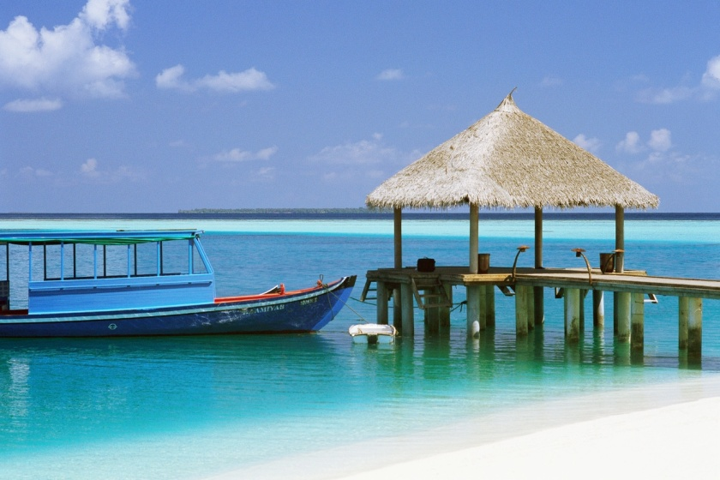
Identify and obtain information to assist with local and national queries
Information on local travel products should cover:
Places to stay, eat and drink
Services in the local area
Facilities
Rates.
Notes:
Trainer advises trainees they also need to obtain information on local travel products and services, such as:
Places to:
Stay – accommodation options available locally including hotels (of different ratings) and back-packer accommodation. Attention should also be paid to identifying any eco-friendly accommodation venues
Eat – covering the differing dining options from eat-in (fine dining to more modest establishments), different cuisine types, street stalls/vendors and fast-food outlets
Bars – and locations for buying take-out liquor
Services, such as:
Hire cars
Money exchanges and banks
Secretarial services for business visitors
Dry cleaning and laundry
Security
Immigration advice
Emergency services
In-house services available to guests at a venue/hotel
Facilities, taking into account:
In-house facilities for guests – spa, swimming pool, gymnasium, business centre, internet connection
Local facilities – as identified above: toilets, disabled access/wheelchair ramps, parking, transportation, arts centres
Rates. This is a very big area and one subject to on-going change. ‘Rates’ refers to the prices charged by providers for the products, services they provide. Rates include:
Room rates for accommodation; for single, double, family, taking into account any allowable discount
Fees to enter an amusement or theme park and/or the cost of tickets and rides
Fees for traveling on cable cars, trains, buses, taxis, ferries
Exchange rates for changing money between currencies
Charges made by businesses for products sold and services rendered such as exchanging money, meals, shopping
Taxations rates and identification of goods and/or services they apply to, and any refunds or rebates international visitors may be entitlement when they leave the country.

Slide 22
Identify and obtain information to assist with local and national queries
Knowledge of local ‘environmental’ issues should address:
Weather
Tides
Sunrise and sunset
Regional conditions
‘At risk’ flora and fauna (if applicable)
Sustainable/environmentally-friendly local features
Eco-tourism options.
Notes:
Trainer recommends to trainees they also capture local information on ‘environmental’ issues which will vary greatly depending on the geographical location of their workplace but should include:
Weather and the seasons: when it is likely to be hot, cold, wet, windy or other as appropriate to the individual location
Tides especially where tourism focuses on boating and fishing
Times of sunrise and sunsets
Regional variations in weather such as identification of micro-climatic conditions for certain areas
Items deemed to be ‘at risk’ – flora and fauna
Sustainable features of the local area/region
Options available for visitors seeking an eco-tourism experience.

Slide 23
Identify and obtain information to assist with local and national queries
Research on information regarding local attractions should focus on:
Natural and man-made attractions
Important and historic buildings
Tours
Events
Places of interest
Local dangers.
Notes:
Trainer suggests to trainees that in regard to obtaining information about local attractions, tours, events and places of interest they should focus their research on:
Natural attractions such as caves, mountains, the ocean/sea, gorges, sanctuaries, gardens, waterways
Man-made attractions (also known as ‘built attractions’) – entertainment centres, amusement parks, theme parks, lookouts, science centres, museums
Buildings – ancient buildings and ruins, government buildings, buildings with historic significance, former prisons and dwellings
Tours. These may be:
Time-based – 2-hour, half-day, full-day, multiple days
Subject-based and may focus on Sports tourism, Landmarks, Food tourism, Cultural tourism, Eco-tourism, Religious tourism, Arts or Area-based. These may focus on, for example:
A town, city or region – a general tour visiting landmarks and other ‘places of interest’ (see below)
The CBD of a city
Shopping precincts
Events. These relate to special occasions conducted in an area and can include:
Sporting events
Religious observances/festivals
Meetings, Incentives, Conventions, Exhibitions occurring in the area
Local and national celebrations.
Trainer notes some local areas prepare a ‘Calendar of Festivals and Events’ detailing the upcoming events for the next 12 months.
Places of interest – this phrase can include almost anything including the already mentioned built attractions, landmarks and ruins, plus natural attractions. It can also cover:
Sites of historic battles
Unique architecture
Groups of ethnic people and their houses, shops, religious shrines
Squares, showgrounds and theatres
Geographical features, fossils and forests
Local dangers. Attention must always be paid to ensuring visitors are provided with appropriate advice regarding any local dangers they may be subjected to, for example:
Wild animals
Currents and tides
Areas they should avoid because of the potential for attack (‘no go’ areas)
Geographical features with the potential to cause death or injury
Activities that may be inappropriate given the profile of the visitor. For example, a walking trail may be suitable for a young and fit tourist but totally inappropriate for a frail and elderly person
Weather conditions – rain, sun, wind.
Class Activity – Group Discussion
Trainer leads trainees in a discussion on information they would provide to visitors to their area regarding ‘local dangers’. Questions may include:
What local dangers do you think visitors need to be made aware of?
Why do think they should be given this information?
How would you provide this detail?
When and where would you provide it?
Who might you contact to make sure you are providing accurate, comprehensive and current safety information to visitors?

Slide 24
Identify and obtain information to assist with local and national queries
Information should also be developed on local customs:
Dress
Language
Personal behavior
Relationship between local events and certain accepted activities and protocols
Legal issues
Generally accepted standard protocols within society.
Notes:
Trainer urges trainees to also develop knowledge to pass on to visitors about local customs, suggesting this could include:
Dress – what to wear; what not to wear, requirements regarding footwear and covering parts of the body
Language – providing basic phrases/words such as ‘Yes’, ‘No’, ‘Hello’
Personal behavior which may address:
Eye contact and other non-verbal communication issues
Shaking of hands when meeting/greeting a person
Local activities related to certain events, circumstances
Legal issues identifying what offences are provided for under relevant legislation
Accepted protocols identifying acceptable and unacceptable actions related to nominated occurrences, events, meetings, circumstances and normal daily life.
Class Activity – Individual Exercise
Trainer asks individual trainees to select one aspect of ‘local customs’ identified on the slide and prepare a comprehensive and accurate list of topics they would cover and information they would provide when advising visitors about local customs.

Slide 25
Store and update information according to enterprise procedures
Organisational requirements can:
Describe type, style, nature, size and location of files and displays
Identify personnel with responsibilities relating to establishment and maintenance of files and information
Identify who is authorised to attend external meetings likely to provide new or revised local knowledge.
Notes:
Trainer presents to trainees that once relevant local information has been sourced, it must be stored for future use as deemed most appropriate by the enterprise, in keeping with any relevant policies and procedures the organisation has in place.
Trainer identifies organisational requirements will vary between establishments but may include policies and procedures relating to:
The type, style and nature of the storage and retrieval system to be used – see following slides (for example, the use of filing cabinets, public display options and the storage of information on electronic (or other) databases)
The type, style, nature, size and location of the information display and/or file which will usually embrace:
Where brochures will be displayed to the public so they can ‘help themselves’ to brochures such as in the foyer area
The materials to be placed in guest rooms – in the compendiums, on side-tables
Information supplied to guests when they check-in
Identification of personnel with responsibility for:
Capturing initial information, brochures, price lists, maps, flyers and promotional material from local and other attractions and venues
Updating the information brochures to ensure it remains current providing up to date materials, prices, opening times
Entering information into an electronic system to enter new or updated data into the system
Maintaining the display to keep it looking neat and tidy and to remove soiled, torn materials
Maintaining the store of materials to obtain materials to ensure the display never runs out of brochures
Identification of who is authorised to attend meetings to capture local information about upcoming events and to participate with others (venues, authorities, attractions) to attract visitors to the local area.

Slide 26

Store and update information according to enterprise procedures
Local information may be stored:
Using electronic systems
Filing cabinets
Public display area
In nominated areas behind reception or concierge desk
A mix of these options.
Notes:
Trainer indicates to trainees storage options for local information may include:
An electronic system such as entering information into a dedicated information database, or one that is integrated with a CRS
A filing cabinet system – filing paper-based material by category or in alphabetical order
A public display area where the public/visitors are encouraged to browse and help themselves to items of interest
Copies of information in nominated areas such as behind reception, at the concierge desk or contained within in-room compendiums
A mix of the above. This is the most common option: very few venues store local information only in one place.

Slide 27
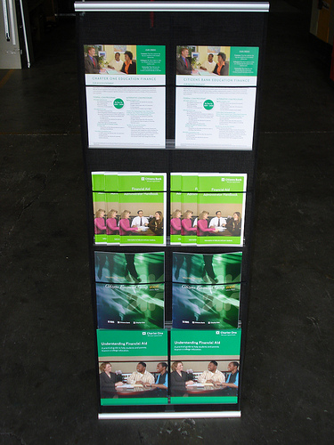
Store and update information according to enterprise procedures
Keys in obtaining local information updates include:
Continue with established activities
Obtain materials from new venues and attractions
Read alerts and newsletters
Pick up new/revised promotional materials
Use your network of contacts.
Notes:
Trainer explains to trainees that updating information requires (1) obtaining the u-dates, and (2) processing the new or revised information.
Trainer states to trainees that activities involved in obtaining the updates include:
Continue to do the activities initially undertaken to capture local information in the first instance, for example:
Visit the Visitors Information Centre
Attend local meetings
Visit other venues and local attractions
Read local newspapers, magazines, books
Obtain materials/information for new venues, attractions. From time to time new businesses and attractions will open and there is a need to be proactive in sourcing information from these to pass on to visitors/guests
Reading alerts, up-dates, emails, newsletters received as these are often sources of new/revised information
Picking up any copies of new tourist/visitor information and arranging to obtain multiple copies
Use network of contacts – can they advise of any new materials/information? Any changes/updates?

Slide 28

Store and update information according to enterprise procedures
Processing new or updated local information can include:
Accessing the electronic database and amending files
Removing and replacing items in public areas and office-based filing cabinets
Changing items in guest rooms
Meeting with the Concierge.
Notes:
Trainer informs trainees the processing of new or updated local information will depend on the system used in the workplace to store this information, but may include:
Accessing the CRS or other dedicated electronic database and adding, deleting or amending files and fields as necessary
Accessing the filing system for hard copy materials and:
Removing and discarding previous versions of materials which will now be out of date due to the new/revised materials
Replacing with the new materials
Removing out of date materials from the display stands and racks and replacing with new/revised materials
Going to each guest room in the venue:
Removing out of date materials from the in-room compendium and side-tables
Replacing with new/revised materials
Meeting with Concierge and:
Advising of new/revised materials
Providing several hard copies to the Concierge who will then update their own files and database at their desk.
Class Activity – Excursion
Trainer arranges to for trainees to visit an accommodation venue with significant displays of local information to:
View the public display areas and identify the items available for the public
View the behind-the-counter or office-based filing systems used for storing local (and other relevant) tourist information
View any electronic database used to store tourism information
Visit guest room to view local information contained in guest room compendium
Talk with management and/or staff regarding:
Benefits and disadvantages of the systems used by the venue for storing and/or displaying tourism information
Processes involved in obtaining new and/or updated local or other relevant tourism information
Activities involved in processing new/updated information so every display and/or storage option is effectively changed to reflect the new or revised information.

Slide 29
Store and update information according to enterprise procedures
When up-dating local and other information files:
Always thank whoever provided the material
Update immediately
Discard all out of date materials.
Notes:
Trainer stresses to trainees it is important for them to ensure the following elements are addressed as appropriate when updating information:
Thank the person, business, authority or body who provided the up-dated material. this acknowledges their effort and encourages them to keep sending new/updated materials
Act on new/revised information immediately. The day the material is received should be the day the old material is replaced with the new material/information
Discard all old and out of date materials. Never leave it lying around the place. It may inadvertently be used to provide incorrect advice/information to guests. Shred the old materials or dispose of them in the trash or recycling bin.

Slide 30

Share information with colleagues
Ways to share information with colleagues:
Tell them
E-mail them
Prepare a handout
Update internal systems
Exchange items in public displays
(Continued)
Notes:
Trainer advises trainees when they have managed to gather and update local information they must be prepared to share such information with work colleagues and incorporate it into their day to day work activities.
Trainer indicates to trainees the basic ways to share new and/or revised (updated) information with fellow employees are to:
Verbally tell your colleagues about what you have learned:
On a one to one basis
At staff briefings
At staff meetings
E-mail co-workers with the information you have discovered attaching relevant information as applicable
Prepare a short handout. Put this:
On the staff notice board
Hand-deliver it explaining it at the time it is handed out
In wages envelopes
In the internal newsletter
Update the internal systems such as CRS, described in the previous Section
Replace and replenish internal displays and/or information points with new/revised materials – also described in the previous Section.

Slide 31
Share information with colleagues
Arrange for a guest speaker from the attraction or venue to talk to staff
Organise for a speaker from the Visitor Information Centre to come and talk to staff
Arrange for venue staff to go and visit venues and/or attractions.
Notes:
Trainer continues to advise trainees about ways to share local information with fellow workers:
Arrange for a guest speaker from the venue/attraction to come and talk to staff explaining the venue/attractions, providing sample items or bringing promotional materials
Arrange for a speaker or representative from the Visitor Information Centre to attend and make a formal presentation to venue staff
Arrange for staff to visit the venue/attraction personally so they can gain first-hand experience of the venue/attraction. Management at attractions usually provide free entry to their site/venue for staff in the hospitality business knowing there is the potential for ‘referrals’ from these people. Ask Manager to arrange the visit, and free entry is almost guaranteed.

Slide 32

Share information with colleagues
When sharing new or updated local information with colleagues:
Be enthusiastic
Sell the benefits of passing this information on to visitors.
Notes:
Trainer suggests to trainees that when informing other colleagues about new or updated local information they should at the same time ensure:
They are enthusiastic when providing local information to other staff at the venue. Enthusiasm can be contagious and unfortunately if they are not enthusiastic, this too is contagious
They sell the benefits of providing up to date, accurate local information to visitors and guests.
These include:
Increased guest satisfaction with their stay leading to:
Repeat business from them. They are more likely to return at a later date and spend more time and money in the venue and in the local area
‘Referral’ business as they tell their friends and family and encourage them to visit or refer them to the venue for accommodation
Very real chance of guests/visitors spending extra nights in the area or at the venue leading to greater financial prosperity for the venue and area
More secure employment at the venue and the potential for venue growth
Increased chance of more work or extra hours for existing staff
Enhanced image of the area, district, town/city and country in the eyes of international tourists/visitors.

Slide 33
Summary – Element 1
When developing local knowledge:
Recognise and appreciate the need to provide local knowledge and information to tourists and visitors
Capture local knowledge from a variety of sources – local Visitor Information Centre, written references, internet, local associations and industry contacts
(Continued)
Notes:
Trainer provides a recap of the Element asking questions to check trainee understanding and responding to questions from trainees, as required.

Slide 34
Summary – Element 1
Be proactive – you have to be interested, you have to make an effort
Subscribe to information sources, visit relevant web sites, read local publications and relevant books and magazines
Visit local Visitor Information Centre and get to know the staff
(Continued)
Notes:
Trainer provides a recap of the Element asking questions to check trainee understanding and responding to questions from trainees, as required.

Slide 35
Summary – Element 1
Join industry associations and attend meetings
Obtain copies of local promotional materials for reference and to distribute
Obtain general information on tourism as well as knowledge about local destinations, facilities, infrastructure, tourism products and services
(Continued)
Notes:
Trainer provides a recap of the Element asking questions to check trainee understanding and responding to questions from trainees, as required.

Slide 36
Summary – Element 1
Become aware of local environmental issues and opportunities
Learn about local attractions, tours, events and places of interest
Make sure you understand and can communicate local customs
(Continued)
Notes:
Trainer provides a recap of the Element asking questions to check trainee understanding and responding to questions from trainees, as required.

Slide 37
Summary – Element 1
Create a public display of local information as well as a private stock and have information in guest rooms and compendiums
Be a tourist in your own area. Visit the attractions a tourist would want to see or go to
Ensure local information is updated as the need to so arises to keep it current
Share what you learn with work colleagues on a regular basis.
Notes:
Trainer provides a recap of the Element asking questions to check trainee understanding and responding to questions from trainees, as required.

Slide 38
Up-date local knowledge
Performance Criteria for this Element are:
Use informal and/or formal research to update local knowledge
Share updated knowledge with customers and colleagues, as appropriate
Incorporate the sharing of local knowledge into day to day working activities.
Notes:
Trainer identifies for trainees the Performance Criteria for this Element, as listed on the slide.
Class Activity – Discussion
Trainer asks trainees questions regarding their experiences and knowledge about updating local knowledge:
Why do you think it is important for local knowledge/information to be kept up to date?
How might a venue ensure it keeps all its local tourism information up to date?
Which staff in the venue might be involved in keeping local information current?
What might be the consequences of not keeping local tourism information up to date?
How could a venue ensure all its staff are kept updated about new local visitor information, or changes to existing local visitor information?
In what ways might staff at a venue incorporate new/updated local information into their day to day activities in dealing with visitors/tourists?

Slide 39

Use formal and/or informal research to update local knowledge
Research to update local knowledge can be done on:
A formal basis
An informal basis.
Notes:
Trainer tells trainees updating local knowledge can be conducted by undertaking research on an informal or formal basis describing:
Informal research is generally research happening more by accident than design or planning. It is information people just ‘come across’ in day to day life as opposed to deliberately searching it out. People often engage in informal research without realising it.
Formal research, by contrast, is more structured, and has deliberate intent although it is possible to see some crossover between formal and informal research. With formal research, activities are undertaken with a specific purpose in mind.

Slide 40
Use formal and/or informal research to update local knowledge
Research can include:
Discussing information with colleagues
Obtaining customer feedback
Personal observation
Informal discussions
(Continued)
Notes:
Trainer presents various research options to trainees:
Discussing information with colleagues; finding out about their local experience, the information they have gained, and what they think
Obtaining customer feedback. This is easily done when talking with them at reception after they have returned from a tour or a visit to an attraction, or at the table when they are having a meal. Keys are to ask plenty of questions, and show genuine interest in what people say.
Personal observation . This takes place when, for example, noticing something, just by chance, regarding an attraction, local event
Informal discussions with friends and family where the topic of conversation happens to include local attractions, festivals

Slide 41
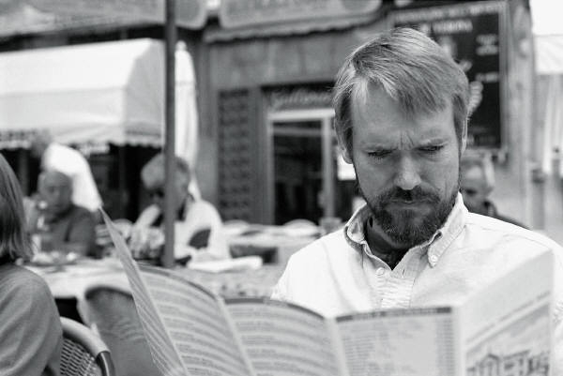
Use formal and/or informal research to update local knowledge
Reading magazines
Reading, watching or listening to local media
Undertaking general internet research
Developing, distributing and analysing questionnaires
(Continued)
Notes:
Trainer continues to present research options for identifying updated local knowledge:
Reading a magazine (especially travel and tourism literature) or any form of printed material and discovering an article about the local area
Reading, listening to or watching the local media to identify what is happening locally, dates, features of the event
Undertaking general internet research. This is an excellent source of information and readily shows things as well as providing simple text. Look for new websites, and ‘bookmarked’ sites that have changed since previous visits
Developing, distributing and analysing questionnaires. This is a paper-based variation (or it may be electronic/online) on verbally asking questions. The production of a questionnaire will enable formalised responses and feedback to given questions and topics.

Slide 42
Use formal and/or informal research to update local knowledge
Attending conferences and seminars
Attending launches and openings
Attending industry functions
Participating in ‘familiarisation’ tours.
Notes:
Trainer continues to present research options for identifying updated local knowledge:
Attending conferences and seminars. Any time there is a conference or seminar on tourism and/or hospitality, make an effort to attend. The key is once again to become involved and be an active participant
Attending launches of new products/services and openings of new venues/attractions. Many local areas will launch a new tourism initiative and it can be very informative to be there when these initiatives are revealed to the public. There is usually significant media involvement in these launches
Attending Industry Association functions. These functions are a good networking opportunity and usually feature many representatives from support and associated businesses
Participating in familiarisation activities. Familiarisations (or ‘famils’) are tours of venues and attractions conducted by the operator to familiarise people (usually industry workers, but it can also apply to the media, potential customers/groups). A famil tour at a venue will include a tour of the venue, viewing of rooms and facilities, a talk by the manager and probably a free meal. At a theme park the famil tour would include free rides, entry to shows, a talk by the manager, participation in shows/tours and also a free meal. The idea of ‘fam tours’ (as they are also known) is to enable staff to return to their workplace and then tell their customers/guests from first-hand experience exactly what the venue/attraction is like and what it is like to go there.
Class Activity – Excursion
Trainer arranges for trainees to be granted a familiarisation tour of a local venue or attraction.

Slide 43

Use formal and/or informal research to update local knowledge
Keys to effective research:
Do it regularly
Take notes
Obtain hard-copy material
Involve others
Share your findings.
Notes:
Trainer advises trainees the keys to getting the most out of research are to:
Do it regularly – it should be on-going
Take notes – never rely just on memory
Obtain hard-copy material – pick up brochures, download and print internet sites, file magazine articles
Involve others – the benefit of involving other people seemingly multiplies learning
Share findings – pass on new information to both colleagues and customers.

Slide 44

Share updated knowledge with customers and colleagues
To share updated knowledge with customers:
Advise of altered situations when talking to them
Mention new options at appropriate opportunities
Asking people what they have already done or seen
Prepare local information packs
Develop a series of local tours.
Notes:
Trainer explains to trainees any new or updated local information must be shared with colleagues and customers in order to enhance service delivery and optimise customer experiences.
Trainer defines, for the purposes of this Unit, ‘customers’ include guests, friends of guests and visitors generally. They can be individuals, families or groups of business people or tour groups.
Trainer presents to trainees options for sharing updated local information with staff:
Advising of altered conditions when talking to customers, guests and visitors. These ‘altered conditions’ may relate to:
Opening hours for a venue, attraction or park
Prices to enter, cost of tickets and tours
Schedules and timetables of shows, buses, trains
Mentioning new options to customers/guests such as:
Telling them about a new park, gardens, attraction
Giving them a brochure about the new/revised attraction
Providing a map and directions about how to get there
Asking people where they have already been and what they have already seen to enable:
Recommendation of attractions they have not yet seen
Provision of information or brochures about those places
Giving first-hand impressions about the attraction , where applicable
Prepare local ‘information packs. These can simply be an assortment of information brochures relating to different types of places of interest, types of tourism, guest interests
Develop a series of tours suitable for guests or visitors. These should be supported by relevant information brochures, schedules and maps and encompass:
Walking tours, self-drive tours, public transport-based tours
Two-hour tours, half-day tours and full-day tours
Night walks.

Slide 45
Share updated knowledge with customers and colleagues
Share updated knowledge with colleagues by:
Verbally telling colleagues
E-mailing co-workers
Preparing a handout
Up-dating internal systems
(Continued)
Notes:
Trainer talks again about ways in which local knowledge may be shared with colleagues in the workplace:
Verbally tell colleagues about has been learned
E-mail co-workers with information discovered
Prepare a handout and distribute
Update internal information systems such as databases and CRS.

Slide 46
Share updated knowledge with customers and colleagues
Replace and replenish internal displays
Arrange for a guest speaker
Organise a visit to the venue/attraction.
Notes:
Trainer continues to talk about ways in which local knowledge may be shared with colleagues in the workplace:
Replace and replenish internal displays. Ensure dated materials are discarded
Arrange for a guest speakerto come and talk to staff
Organise a visit to the venue/attraction for staff to gain first-hand experience and knowledge.

Slide 47
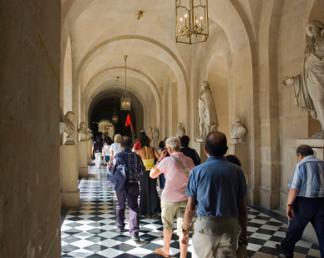
Incorporate sharing of local knowledge into day to day working activities
To incorporate sharing of local information into everyday activities:
Prepare local trips/tours
Full-day trips
Half-day trips
Two-hours trips
(Continued)
Notes:
Trainer highlights to trainees that it is critical for all venue staff to incorporate the sharing of local knowledge and information into day to day working activities with customers/visitors.
Trainer presents options to achieve this as:
Prepare some local trips/tours. The key aims of doing this are:
To try to get the guest to stay another day or more
To maximise their enjoyment during their stay to bring repeat and referral business.
The full-day trip should spell out:
The route to take
The distances involved
The times allowed for
Details of all the destinations. Aim to put together as many of these types of trips as possible. There may be subtle changes between similar trips based on different opening days/hours for some attractions. For example, the area may have certain attractions not open on Tuesdays and Wednesdays.
Half-day trips:
Should aim at a four-hour trip. There may be different ones for different days (again, because some places may not be open at certain times, or the animals are only fed at 4:00PM, or the tide comes in at a certain time), and different ones for the morning and afternoon. Different ones may be prepared to cater for different weather conditions. There may be different ones for different seasons especially where natural attractions are involved. Night walks are a fairly common extension of this concept
Two-hour tours:
Are for people who want to squeeze a little bit extra in today, or before they depart the area tomorrow. The same advice as for the other types of trips applies. The trip is just shorter. Perhaps divide a half-day trip into two, or it may be a totally new idea.
It is a good idea to create one of these trips between the venue and the airport, for example, so the guest/visitor can a little bit extra on their way ‘home’.
These ‘trips’ can be ‘mud maps’ with hand-written features or produced on the workplace computer and printer. They can be professionally produced and printed for distribution.
Naturally the trip preparation or itinerary should be certain to describe any potential pitfalls, dangers, obstacles, hazards, or warnings. It should also list any items people should take with them. This may include petrol, sun screen, drinking water, coins for machines, a hat .
Depending on clientele, prepare trip handouts in different languages to cater for the cross-section of international visitors the venue attracts.
Class Activity – Small Group Exercise
Trainer divides trainees into three groups and asks:
Group 1 to prepare a full-day tour for the region
Group 2 to prepare two half-day tours for an area
Group 3 to prepare four two-hour tours for the area.
Tours should be shared with the rest of the group, for comment and feedback.

Slide 48
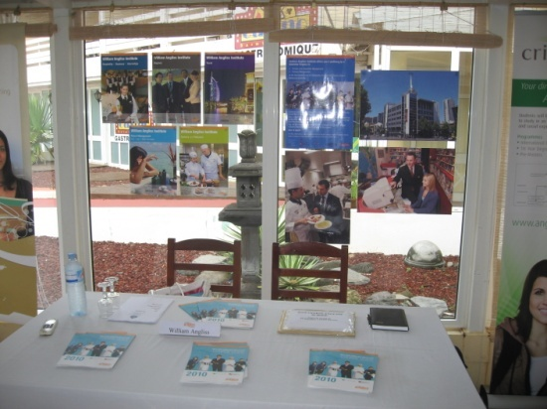
Incorporate sharing of local knowledge into day to day working activities
Develop a local information list
Tell people what you know
Inform regular visitors on arrival
Maintain internal files
Up-date public displays.
Notes:
Trainer continues to present ways in which trainees can share local knowledge by incorporating to into day to day activities:
Develop a local information list . If the local Visitor Information Centre does not already have any suitable lists accommodating this need, then it is up to venues to meet this need by creating their own list to help visitors. Consider making a big production out of this. Make the workplace venue a central feature, but be prepared to sell space to other operators who are likely to benefit (to help defray the costs of production). The list should cover:
Local attractions
Tours
Opening hours of attractions
Costs of tickets
Distances of the attractions from the venue and time to travel there.
Tell people. This should include:
Involving all front-of-house staff in telling customers what is available. This can include:
Reception staff on guest arrival
Waiting staff in dining areas
Bar staff in bars
Making it standard procedure for staff to ask customers/guests what they have seen or done. They can then recommend something they have not seen, and something they have not yet done.
Providing relevant support materials to optimise the chance of customers/guests taking up suggestions made by staff. These can include maps, brochures, promotional materials
Using personal experience as the basis for making suggestions by telling customers of their own experience at the attraction or on the tour. it is this ‘personal’ and first-hand experience which commonly makes the difference between whether a guest takes up the suggestion or not.
Advise regular visitors on arrival:
If aware a regular visitor/guest is arriving tomorrow and they love to go fishing in the local tidal river, then make sure they are provided, on arrival with, for example:
A current copy of the tides and times
A current price list of the boat hire charges from the local hire shop.
The same idea applies for any regular visitor if their tastes, preferences and hobbies are known.Go ahead and make the extra effort. It often will not take much to stand out from competitors because all too often they do nothing so it does not take much to beat them in this regard. Just follow through and take the necessary action.
Maintain internal visitor information files. Update as required and discard dated brochures. Capture brochures/information for new venues, facilities and attractions. Nominate a person to be responsible for this
Make sure brochures provided in the public displays and other areas (in-room compendiums, concierge) are updated, kept filled and current

Slide 49
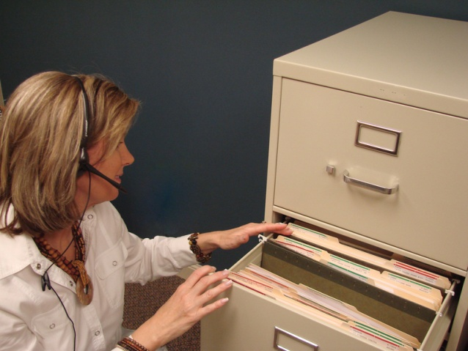
Incorporate sharing of local knowledge into day to day working activities
Never just say ‘Sorry, I don’t know’ when a visitor asks a question:
Take action to find out the answer:
Make a phone call
Ask another staff member
Refer to your library/files
Find the answer
Get back to the visitor and tell them what you found.
Notes:
Trainer explains to trainees that noone can possibly ever know the answer to every question visitors might ask BUT they are also never expected to just answer an enquiry they do not know about with a silly grin and the words ‘Sorry, I don’t know’.
Trainer urges trainees if they do not know the answer to a guest/visitor question it is acceptable to say they do not know the answer but they must then take appropriate action to follow-up, find out and get back to the visitor with the required information. This may involve:
Making a phone call for the tourist/visitor to the actual attraction or hotel they are making enquiries about, or phoning the Visitors Information Centre
Asking someone else if they know. There may well be another staff member who does know and who may be able to help.
Referring to local library of tourist information. this could assist with finding out, for instance, prices, and the finer details (such as opening times, credit cards accepted).

Slide 50
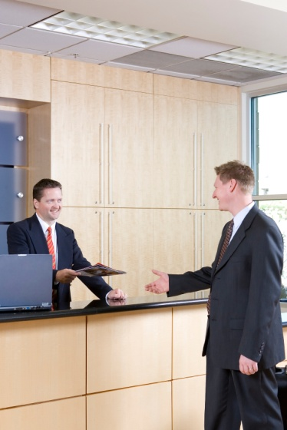
Incorporate sharing of local knowledge into day to day working activities
Treat all visitors as needing help and friendship:
Talk to them
Smile
Offer to help
Provide information
Offer advice
Show an interest.
Notes:
Trainer stresses trainees must always remember most visitors are, obviously, not locals and hence do not have the same ‘local knowledge’
many people take for granted.
Visitors need not only to be given local knowledge but also treated appropriately and helped which can involve:
Talking to people as opposed to ignoring them (which makes them feel unwanted, unappreciated and like an intruder)
Smiling. It is a universal language … and smiling is free.
Offering to help without waiting to be asked. Read people’s body language and be proactive in making an offer of help or assistance
Providing information willingly in response to questions
Providing advice to supplement the information and to individualise the information given. Refer to personal experience
Showing an interest in them as individuals.

Slide 51
Summary – Element 2
When updating local knowledge:
Be active – never expect information to come to you. You have to go and get it
Use formal and informal research techniques to source local information
Organise familiarisation tours of local venues and attractions
Research on an ongoing basis. You cannot research local information once and believe that is all there is to it
(Continued)
Notes:
Trainer provides a recap of the Element asking questions to check trainee understanding and responding to questions from trainees, as required.

Slide 52
Summary – Element 2
Take notes about information you discover
Share new and/or revised local information with work colleagues so they too keep up to date
Integrate new/revised local knowledge into activities designed to enhance visitor experience, and encourage repeat and/or referral business
(Continued)
Notes:
Trainer provides a recap of the Element asking questions to check trainee understanding and responding to questions from trainees, as required.

Slide 53
Summary – Element 2
Tell visitors about new/revised local information. Never wait to be asked: be proactive in sharing local knowledge with everyone
Develop local tours for visitors to enjoy – 2-hour, half-day and full-day trips
Develop a list of local contacts you can use in order to help visitors with a specific need for local information
(Continued)
Notes:
Trainer provides a recap of the Element asking questions to check trainee understanding and responding to questions from trainees, as required.

Slide 54
Summary – Element 2
Involve all customer contact staff in providing local information and knowledge to visitors
Never reply to a visitor request for information with a simple ‘I don’t know’ – find out, and pass the information on
Always remember the need to be friendly and helpful to all tourists and visitors.
Notes:
Trainer provides a recap of the Element asking questions to check trainee understanding and responding to questions from trainees, as required.

Slide 55
Maintain contact with local communities
Performance Criteria for this Element are:
Provide accurate local tourism information in response to queries
Use local knowledge to promote tourism products and services to encourage usage and purchase
Make customers aware of possible extras, add-ons and further benefits
Report queries and results to designated person within enterprise for follow-up purposes.
Notes:
Trainer identifies for trainees the Performance Criteria for this Element, as listed on the slide.
Class Activity – Discussion
Trainer asks trainees questions regarding their experience in relation to maintaining contact with local communities and what may be done to optimise spending and visitor enjoyment of their stay in the region/area:
Why is it important to maintain contact with local communities?
How might this occur?
What can a venue/attraction do to demonstrate it is trying to support the local community?
What is meant by ‘tourism products and services’?
How might local knowledge be used to encourage visitors to purchase and/or use local tourism products and/or services?
What are examples of add-ons and extras that staff may sell/suggest to visitors when promoting local tourism products and services?
Why might management at a venue or attraction want to know about the type of questions asked by visitors, and the effectiveness of the way staff respond to those questions?

Slide 56
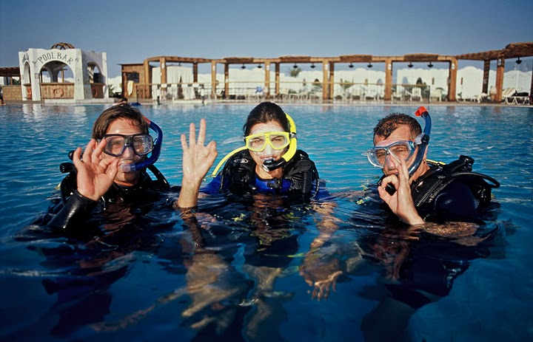
Maintain contact with local communities
To develop and update local knowledge it is important to stay in contact with local communities. These include:
Other businesses
Local groups, clubs and interest groups
Local individuals who are active in promoting the area
Anyone or any organisation involved in organising local events
Notes:
Trainer reminds trainees in order to develop and update local knowledge effectively it is necessary to be proactive. Part of taking the initiative in this regard is the need to maintain contact with local communities.
Trainer states ‘local communities’ can include:
Other businesses in the area of any type. There is always a possibility a visitor may need to contact any type of business. Also it is important to form good working relationships with other businesses and to cooperate with them for mutual benefit
Local groups, clubs and interest groups who conduct events and/or support local tourism initiatives
Individuals who are active in promoting the local area. These are often the people who initiate events, work with other tourist destinations for mutual benefit and who work to bring visitors into the area.
In brief, anyone or any organisation involved in organising local events or operating local businesses or attractions can be seen for the purposes of this unit as a ‘local community’.

Slide 57
Maintain contact with local communities
Keys in staying in touch with local communities require a mix of:
Joining local groups, organisations and associations
Participating in what local groups are doing
Keeping in contact with local groups and network of contacts
(Continued)
Notes:
Trainer informs trainees the keys in staying in touch with local communities require application of a mix of the following activities:
Joining local groups and attending their meetings
Participating in what local groups are doing including contributing assistance, information and resources to help them achieve outcomes that are mutually beneficial. Participation must be active and it must be substantial (that is, not just verbal support)
Contacting them on a regular basis. Visit them face to face or telephone them regularly

Slide 58
Maintain contact with local communities
Asking and encouraging them to make contact with you
Thanking them when they make contact
Offering your venue as a place for meetings.
Notes:
Trainer continues to tell trainees of the keys in relation to maintaining contact with local communities:
Ask them to make contact. Encourage them to call/contact the venue and make it easy for them to do so. Let them the venue wants to maintain contact with them
Thank them whenever they make contact to encourage them to keep in contact
Offer the venue as a meeting place to keep the venue and its commitment to mutual promotion of the area firmly centred in their minds.
Class Activity – Guest Speaker
Trainer arranges for a speaker from a local ‘community to talk to trainees about:
The role of the organisation to which they belong regarding local tourism and promotion of the local area
How trainees might join the organisation
Cost to belong, if applicable
Examples of events they have organised
Details of where and when they meet and the duration of meetings
Advice they can give regarding promotion of the local area to visitors.

Slide 59

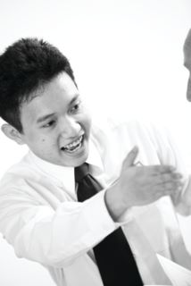
Provide accurate local tourism information in response to queries
Effective responses to visitor enquiries must be:
Honest
Comprehensive
Up to date
Relevant
Timely.
Everyone has responsibility for answering visitor queries.
Notes:
Trainer stresses to trainees that it is important for them to provide accurate responses to all tourist queries, explaining effective responses to a visitor query about the local area must be:
Honest. Never tell an untruth or a half-truth about anything. Never say something is ‘good’ or ‘worth seeing’ unless it genuinely is.
Comprehensive. Never tell a person ‘only the good bits’. If there are bad aspects to something, these must be presented and explained. For example, if the tour is excellent but is hot and dusty, tell people it is/can be hot and dusty
Up to date – all details about all aspects of the response (costs, times, opening hours, displays on show, animals ) must be current
Relevant. It is important to add any information that relates to the query but which has not been specifically asked about. For example, if the attraction does not have credit card facilities, EFTPOS or ATMs then tell people they will need to take cash with them when they visit
Timely. All responses must be given in a timely manner. In practice this means ‘straight away’ subject to the need to make enquiries (such as making a telephone call, or looking at an information database) on behalf of the tourist to determine specific information they are seeking.

Slide 60
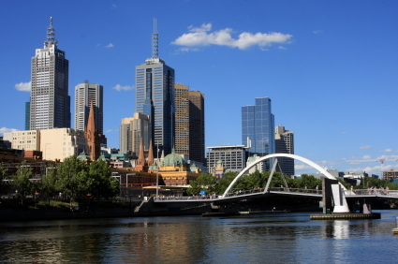
Provide accurate local tourism information in response to queries
You must have information about the following to meet visitor needs and expectations:
The enterprise where you work
Local transport
Local attractions
Local events
(Continued)
Notes:
Trainer emphasises to trainees the need for their venue to obtain sufficient local information to meet expected and identified visitor needs. This will vary between properties and is often dependent on the geographic location where the venue is situated.
Trainer identifies information about the following must be available to respond to visitor enquiries:
Venue knowledge. Also known as 'product knowledge' this covers details about the venue such as:
When certain facilities (swimming pool, gymnasium, spa, bars) are open
Prices –for everything the venue has to offer: drinks, meals, rooms, services
How to make a booking –for a room, dining reservation, the tennis courts
Check-out times
The rooms and/or tables with the best views
Arrangements for parking
Type of credit cards taken
Procedures and policies for a range of things such as lost and found items; deposits, discounts and refunds; security and safety of guests; dealing with complaints .
Local transport. Staff must have a basic working knowledge of what is available including:
Transport options – especially trains, trams, buses but also taxis, hire cars and other more local alternatives such as tuk tuks, rickshaws, trishaws, pedal bikes
Cost
Where the station and bus stops are
Frequency of public transport (buses, trams and trains) supplemented by current timetables. More detailed information should be in the in-house file together with contact details enabling even more detailed information to be accessed when required. In some locations, transport options can include all manner of modes of transports from canoes, to camels and four-wheel drives. They can include buggies, horses, motor bikes, scooters and push bikes. They may cover motor boats, ferries, and airplanes and helicopters.
Local attractions. This must address:
What is available
How far away it is
How long it will take to get there and return using a variety of commonly used transport/travel options
What there is to see when they get there – displays, animals, activities, rides, tours
How much it costs to enter the attraction, to go on a tour, to buy tickets for the rides or shows
When it is open, including when it closes
Man-made and natural attractions. Where the natural attraction conceals or contains some sort of danger this must be highlighted. The danger may be information about wandering stock, dangerous/wild animals, the possibility of dehydration, and the length (in terms of meters/kilometres and in terms of time) of walks.
Local customs must also be addressed so visitors do not give unintended offence to the locals.
Local events. There should be:
A list of all local events – dates and (where applicable) times
Venues participating in the event/hosting parts of the event
Cost to attend/participate
Background to the event – why it is being held; local/national history of the event
Protocols (if any) associated with the event. For example, things visitors should not say or do while attending the event.
Class Activity – Class Discussion
Trainer identifies one local event and asks trainees to contribute items of information about this event that should be communicated about it to visitors from another country.
Trainer records all contributions on the board for trainees to copy down.
Attention must be paid to following up any information by trainees considered ambiguous, incorrect or controversial.

Slide 61
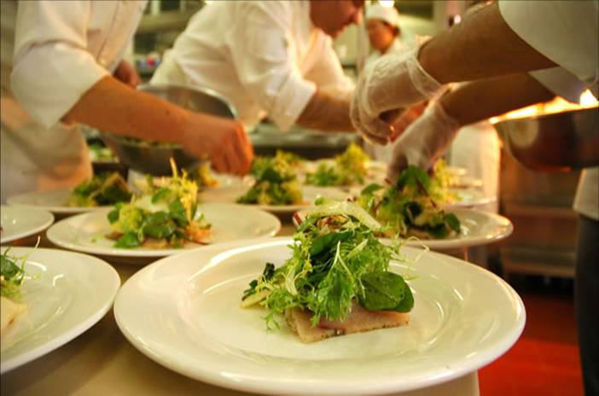

Provide accurate local tourism information in response to queries
General visitor facilities
Dining options
Personal business services
Entertainment
(Continued)
Notes:
Trainer continues to explain that nformation about the following must be available to respond to visitor enquiries:
General visitor facilities. In-house local information file should contain information about:
Shopping locations
Markets
Currency exchange sites
Post offices
Banks and ATMs
Emergency services
Dining options including all types/styles (fast-food, take-away food, local cuisine, western cuisine, fine dining) and bars/drinking venues. Before recommending a dining or drinking venue it is best to ask some questions of the guests so an appropriate recommendation can be made. Questions could include:
Do they want a quick meal, or a full night out?
How much do they want to spend?
Do they have transport?
Do they want a ‘local’ experience?
A menu of the dining venue should be provided where possible so visitors can gain a better idea of the venue before they attend.
Personal business services. This may include a detailed list (name, address, contact details, prices, plus other relevant information as indicated by the precise nature of each business) of local:
Dentists
Doctors
Chiropractors
Beauticians
Remedial masseurs
Podiatrists
Travel agents
Computer technicians – many people travel with a lap-top and need occasional but absolutely crucial IT support.
Entertainment. This should embrace:
Theatres
Cinemas
Entertainment venues
Natural swimming spots (beaches, rivers, lakes), beaches and swimming pools
Local sporting clubs
Sporting facilities
Health clubs and gymnasiums
Golf courses
Shooting ranges
Fishing spots
Tours and tour organisers.
Class Activity – Small Group Exercise
Trainer divides trainees into four groups, and:
Allocates each group one category from the above slide
Asks each group to compile in (for example, 30 or 60 minutes) as much local information as possible about the category they have been allocated
A representative from each group shares their list of information with other groups at the end of the allocated time
Feedback and comment from all trainees is encouraged
Attention must be paid to following up any information by trainees considered ambiguous, incorrect or controversial.

Slide 62
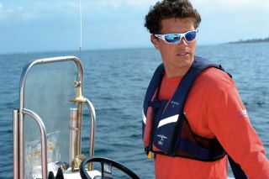
Provide accurate local tourism information in response to queries
Travel
Weather
Local visitor guides
Local people
Government requirements – laws and regulations.
Notes:
Trainer continues to identify information about the following must be available to respond to visitor enquiries:
Travel. Important requirements are to have:
Local maps
A street directory
Updates, alerts, advice and information from local police and motoring/car clubs
Weather. This should include short-term and long-term forecasts for the local area, as well as other locations in the country. The local newspaper may be sufficient to enable these to be provided or there may need to be a relationship with the Bureau of Meteorology (or similar)
Local visitor guides. These are one of the most asked for items of visitor information. Contact local Visitor Information Centre to ensure sufficient quantities to:
Put in guest rooms
Display in public areas
Distribute from the reception desk.
Local people. This is a list of people from the local area who have agreed to be on the list and who may be helpful and prepared to help. These can include visitors in various capacities such as:
Providing local knowledge
Being a local tour guide
Assisting with research
Introducing people to local businesses, groups
Government requirements. This is a list outlining or detailing:
Local, regional and national laws that visitors must abide by such as issues relating to:
Taxes payable by tourists and rebates (where applicable)
Prohibitions on goods that can be taken out of the country
Documentation required to take nominated items out of the country
Immigration and visa requirements.
Class Activity – Guest Speaker
Trainer arranges for one or more representatives from Government agencies to attend and talk to trainees about:
Issues that tourists/visitors need to comply with when in the area
Materials available to support communication of these matters
Penalties that may apply
Level of tolerance, if any, with out of country visitors who breach legislated requirements
Help available from authorities and agencies to assist venues inform visitors of local, regional and/or national legal requirements.

Slide 63

Use local knowledge to promote tourism products and services
When promoting tourism products and services:
Be proactive
Aims are:
Enhance visitor experience
Encourage longer stay.
Notes:
Trainer reminds trainees when using local knowledge to promote tourism products and services they must remember:
To be proactive. It is vital an effort is made to sell these things: they will not ‘sell themselves’
The aims of promoting tourism products and services are to:
Enhance/optimise the tourist experience. Local knowledge and local tourism products and services should enhance the visitor experience of the country/local area
Encourage tourists to stay another night or two in the area. The longer people stay, the more they are likely to spend to help the local economy or community.

Slide 64
Use local knowledge to promote tourism products and services
Always use local knowledge when selling tourism products and services because:
It is a main determinant of the visitor experience
It enriches the visitor experience
It helps visitors feel like locals
It demonstrates acceptance of visitors
Local knowledge can be the local experience.
Notes:
Trainer tells trainees they must always use local knowledge when promoting local tourism products and services because:
The local knowledge passed on to tourists, customers, guests or visitors often decides whether or not the person has an enjoyable experience or not. This is a prime consideration in determining if those people generate return or referral business from the venue and/or the area or country.
Local knowledge ‘enriches’ the tourism experience.
Local knowledge enables the tourist/visitor to differentiate themselves from other tourists/visitors who do not have ‘local knowledge’ and hence cannot avail themselves of the benefits this local knowledge brings
Sharing local knowledge is an excellent way of demonstrating acceptance of the visitor/tourist. In many ways sharing local knowledge is like sharing a secret and there are many positive attitudes and orientations implicit in the simple act of passing on such information. Sharing local information is a way of:
Demonstrating respect for the other person and regarding them as ‘an equal’
Proving the desire to provide a memorable experience for the person
Deeming the other person as worthy of local secrets and information
Allowing the other person an insight into the country, culture they would not otherwise have
Sharing local knowledge is often the local experience. Without this local knowledge there would be little or no ‘local experience’ for the person to remember and talk about after they have departed.
Class Activity – Guest Speaker
Trainer arranges for guest speaker from a local attraction or tourist body to attend and talk to trainees about:
The importance of promoting local tourism products and services
What the local tourism products and services are
Techniques for promoting local tourism products and services
Examples of how they have promoted local tourism products and services
Support for the promotion/sales of local tourism products and services.

Slide 65
Use local knowledge to promote tourism products and services
Use local knowledge to:
Tell visitors latest information
Advise how to get to a destination
Inform visitors about local ‘conditions’
(Continued)
Notes:
Trainer informs trainees they should use their local knowledge to:
Tell visitors the latest information about the area or an attraction
Advise how to get to a destination/attraction – the best or quickest way, the most interesting way or a different way
Inform them about local conditions such as telling visitors of local traps and pitfalls to avoid

Slide 66
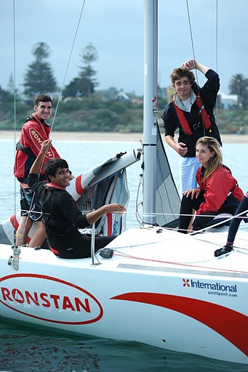
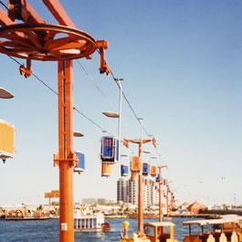
Use local knowledge to promote tourism products and services
Compare one option against others
Advise where the locals go and what they do
Advise best time to visit places
Explain good, local value for money
Identify good places to eat, drink and shop.
Notes:
Trainer continues to inform trainees they should use their local knowledge to:
Compare one option against another so visitors can make informed decisions about what to do, where to go, what to buy
Let visitors know where the locals eat, swim, fish, relax so they can get a true ‘local experience’
Indicate the best time of day to visit an area, landmark or feature in order to get the most from the experience
Explain what constitutes best value for money locally by offering alternatives and through basing options on local prices
Identify the best restaurants, bars and shops based on identified visitor needs and preferences.

Slide 67

Use local knowledge to promote tourism products and services
When using local knowledge to promote local tourism products and services:
Do not wait to be asked
Make suitable time-based suggestions
Be enthusiastic
Follow-up with visitors on their return.
Notes:
Trainer emphasises trainees must be proactive when promoting local tourism products and services meaning they must:
Offer the local knowledge/information without having to be asked. If, for example, a tourist has asked about a local tourist attraction and there is an additional and interesting destination on the way to that attraction, they should be told about it, how to get there, and what the additional destination is all about.
Making suggestions about what tourists/visitors can do with their time by:
Asking what they have planned for the day
Asking what they have already done which identifies local things they have not done, or local sites they have not visited
Developing 2-hour, half-day and full-day tours – see earlier notes/slides
Showing enthusiasm for the suggestions made. There is a need to be 100% committed to how much fun an experience or attraction is, what a unique experience it is or how sad it would be for the person to be close to the attraction and not get to see or experience it. Implicit in this is the need to have pride in country, local area. In very many ways frontline staff are ambassadors for their region, country and venue.
Talking to people after they return from a trip or experience suggested to them. This means asking them how they enjoyed it or what they learned. This conversation is also important because it provides feedback about whether or not the recommendation should be repeated to other visitors or not. It also provides feedback about what may have changed at the place or destination recommended.

Slide 68

Use local knowledge to promote tourism products and services
Tourism products and services include:
Attractions
Destinations
Accommodation
Tours and trips
Landmarks and places of interest
Transportation
Specialist areas of interest.
Notes:
Trainer explains to trainees there is no strict definition of exactly what constitutes ‘tourism products and services’ stating from a practical viewpoint. The term should be interpreted in the widest possible context to embrace anything the venue and the local area has for sale.
Trainer mentions to trainees some will insist ‘tourism products and services’ refers more particularly to items (products/goods and services) specifically aimed at tourists, such as:
Attractions – generally natural attractions or commercial attractions where people pay to enter
Destinations – a general location, area, village or location
Accommodation – venues of all types/star-ratings
Tours and trips – using any method of transport
Landmarks and places of interest – any place a visitor may wish to visit, see, enjoy (often historically significant)
Transportation – public or private
Specialist areas of interest for groups/tourists such as nominated shopping precincts, sporting events, religious festivals or local celebrations.

Slide 69
Use local knowledge to promote tourism products and services
Tourism products and services can also include:
Cell phone cards
Petrol
Meals and drinks
Pharmaceutical products
Cigarettes.
Anything bought locally!
Notes:
Trainer informs trainees ‘local tourism products and services’ may also be seen as including a vast range of small and ancillary items all visitors may purchase as part of their day to day living requirements while on holiday or abroad, such as:
Cell phone cards to recharge their phone
Petrol for their own cars or hire cars
Meals and drinks including ‘proper’ meals, snacks, ice cream, take-away food
Pharmaceutical products – cosmetics and health products
Cigarettes and other items from stationers
Items of clothing
Anything visitors pay for.
Class Activity – Group Discussion
Trainer leads class in a discussion to identify the products and services a visitor to the area may purchase, and to identify the value of those purchases to the local community, by asking questions such as:
What physical products might a visitor from elsewhere within the country to this area need to buy?
How might these purchases differ to what an international visitor might need to buy?
What is the value of these purchases?
What is the local benefit of these purchases?

Slide 70

Use local knowledge to promote tourism products and services
Reasons to promote local tourism products and services:
Meets expectations
Better job satisfaction
Enhances job security
Demonstrates a willingness to serve
(Continued)
Notes:
Trainer advises trainees the reasons to promote local tourism products and services include:
Meets visitor/tourist expectations. It could be said failure to promote local products and services is a disservice to customers
Provides better job satisfaction. Work is more interesting when talking with others, learning from them, meeting new people
Enhances job security and enables extra hours to be worked
Identifies the individual worker as someone trying to help visitors and may identify them to management as someone with the potential for promotion or career advancement

Slide 71
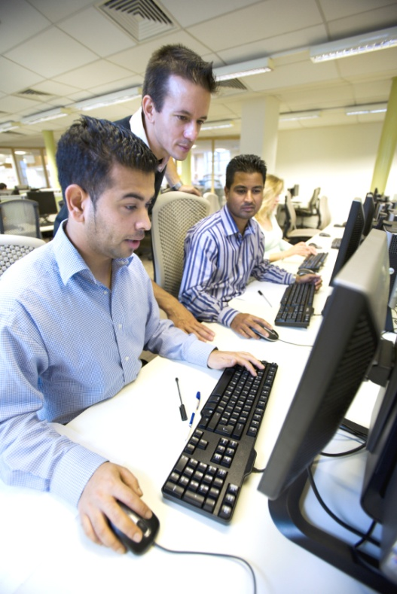
Use local knowledge to promote tourism products and services
Allows learning to occur from others
Increases chances of tips
Proves venue is a good corporate citizen
Supports ongoing viability of the workplace
(Continued)
Notes:
Trainer continues to advise trainees about reasons to promote local tourism products and services:
Allows learning from other people to occur and creates the potential for a greater network of contacts
Increases the possibility of tips/gratuities. However it is important never to give the impression a tip is being sought or is expected
Demonstrates the venue is a good corporate citizen by sharing wealth and opportunity with others and the local community
Assists workplace maintain its ongoing viability by generating extra revenue and repeat and/or referral business

Slide 72
Use local knowledge to promote tourism products and services
Supports local businesses and communities
Enhances visitor enjoyment
Shares local culture
Increases understanding and appreciation of the country, its people, issues, culture, customs.
Notes:
Trainer continues to advise trainees about reasons to promote local tourism products and services:
Supports local businesses and the local community by generating income for them which creates and maintains local industry, employment
Enhances visitor/tourist enjoyment of the local area/region
Shares the local culture with visitors enabling better appreciation and understanding of the country/region amongst visitors/tourists
Gives greater insight into, and understanding of, the people and the country to overseas visitors.

Slide 73
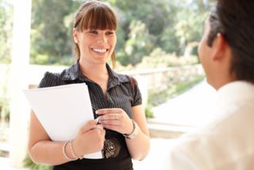
Make customers aware of possible extras, add-ons and further benefits
Keys to effective selling of extras and add-ons:
Establish rapport with visitors
Use local knowledge
Be positive and approachable
(Continued)
Notes:
Trainer highlights to trainees that when sharing local knowledge with visitors/tourists an opportunity regularly exists to make these people aware of possible extras, add-on and other benefits. These opportunities should be taken whenever possible to optimise guest/customer satisfaction and enjoyment, and maximise sales.
Trainer identifies to trainees the keys to effectively suggesting extras, add-ons and features to visitors and tourists include:
Establish a rapport with the visitors/tourists. This facilitates the exchange of ideas, questions and information. It increases the trust between the parties and encourages people to ask questions and to ask for advice
Make use of local, venue and product knowledge. The advice or information provided must be based in fact but overlaid with personal opinion and recommendation
Be positive and approachable. Be seen by tourists as someone who will help them, who is prepared to spend some time with them and who wants to share what they know. Open body language and smiling are important assets in this regard.

Slide 74
Make customers aware of possible extras, add-ons and further benefits
Be polite and respectful
Apply appropriate questioning and listening skills
Match suggestions to identified needs, wants and/or preferences and interests
(Continued)
Notes:
Trainer continues to identify to trainees the keys to effectively suggesting extras, add-ons and features to visitors and tourists include:
Use polite and respectful language when communicating. The idea is to include the visitor in the conversation without making them feel they are silly for asking the questions they have, or are being ‘spoken down’ to
Apply questioning and listening skills. It is always useful and important to find out about the interests, needs, wants, preferences and constraints of people before providing local knowledge and/or advice on add-ons and extras. For example, are they interested in theme parks or natural attractions? How long do they have? What have they already done or seen? How much do they have to spend? How would they prefer to travel?
Match suggestions to identified need, parameters. If the visitor demonstrates an interest in theme parks it is inappropriate to start promoting the add-ons associated with visiting the local zoo. Talk about the extras, add-ons and benefits allied to what is known about the local theme parks - for example, the benefits associated with pre-purchasing ride tickets, entry tickets and tickets to shows/displays. If the tourist only has half-a-day, there is little point suggesting the benefits associated with a full-day tour.

Slide 75
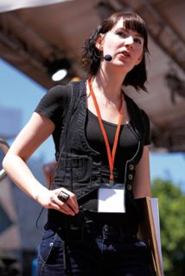
Make customers aware of possible extras, add-ons and further benefits
Know when to stop trying/promoting
Explain the characteristics of the offer
Sell the benefits
Tell the truth
Never pressure people into buying.
Notes:
Trainer continues to identify to trainees the keys to effectively suggesting extras, add-ons and features to visitors and tourists include:
Know when to stop. Be alert to the potential for visitors not to want to be given information about add-ons. Recognise these verbal and non-verbal cues quickly and stop ‘promoting’: insisting on trying to sell extras can only be counter-productive in these cases
Explain the characteristics of the add-ons and extras. These are the tangible factors related to the product or service: see ‘Examples of possible extras and add-ons’ on following slides
Describe the benefits of the add-ons and/or extras. These commonly relate to cost and time saving: see following slides
Tell the truth. Never adopt the belief there is a need to make a sale ‘at any cost’. Always be honest in everything, including telling people about any potential down-sides of suggestions or offers
Never put pressure on people to buy add-ons or extras. Make people aware of options and give them advice but never try to force people to purchase add-ons or extras.

Slide 76
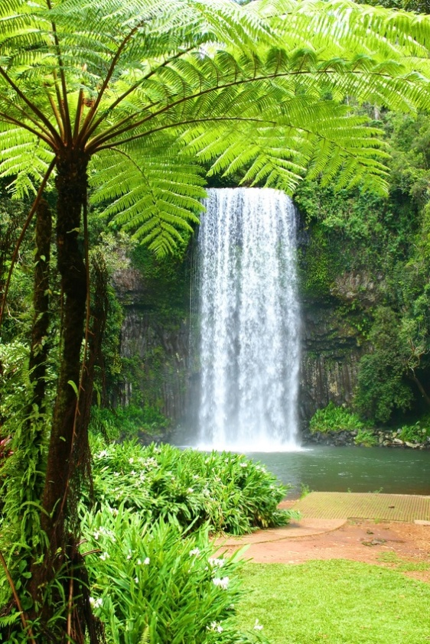
Make customers aware of possible extras, add-ons and further benefits
If visitor says they want a local tour, you could:
Promote a different, more expensive one, highlighting:
It is longer
They see and experience more
They receive more ‘products’.
Notes:
Trainer highlights to trainees that selling extras and add-ons is all about promoting ‘complementary’ products or services.
Trainer provides the following examples of keys to effective promotion:
If the visitor has indicated they want to participate in a local tour, try to sell them a different tour (a more expensive one) to what they originally indicated they were going to undertake because it enables them to benefit from tangible elements such as:
It is a much longer tour – an extra two hours
It covers more things – for example, they might:
See more animals
Experience more shows
Participate in extra activities
Have access to restricted areas
It gives them more products such as (perhaps):
Merchandise – cap, T-shirt, pen
A photograph of them with animals, standing in front of a monument, on a chair lift

Slide 77
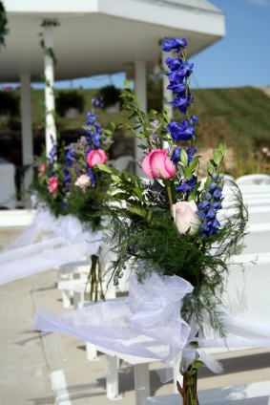
Make customers aware of possible extras, add-ons and further benefits
Examples of selling the benefits of an extra/add-on should focus on things such as:
Time saving
Cost saving
Prestige
A unique opportunity.
Notes:
Trainer provides trainees with examples of ‘selling the benefits’ (as opposed to the physical characteristics) of the add-ons and/or extras :
Pre-purchasing a certain ‘package’ may mean they do not have to queue on arrival at the theme park, zoo, to gain entry (time saving)
Buying a book of tickets means the cost of each ride is cheaper (cost saving)
Purchasing a tour means elements of the tour/packages are bundled and they receive better value for money (cost saving)
This particular tour is only available at this location and nowhere else in the world (making it ‘unique’ and giving it prestige)

Slide 78
Make customers aware of possible extras, add-ons and further benefits
Focus efforts on benefits for the visitors. For example:
They will get a better view if they take your advice
They will enjoy more engagement with locals if they follow your suggestion
They will miss out if they do not ‘do it’ now
Your recommendation is best value for money.
Notes:
Trainer further identifies trainees should use their local knowledge to advise people regarding their purchases by recommending a certain ‘add-on’ or ‘extra’ because:
It will give them a better view. For example, buying a higher-priced seat may mean the tourists are not looking into the sun, or they are sitting in a shaded area
It will enable them to have greater engagement with more/different people or animals or experiences or sites
The offering is only available today, this week, this month, this season, this year
The more expensive 4:30PM tour is better than the 10:00AM one because the later tour includes the feeding of the animals
Taking the cable car to the gardens will provide a spectacular view over the bay, the mountains and the city and it avoids heavy local traffic congestion.
Class Activity – Small Group Exercise
Trainer divides trainees into small groups and asks each group to:
Identify a tourism product or service
Identify the extras and add-ons that could complement the product or service
Explain how the identified add-ons/extras could be sold by describing the:
Physical characteristics of the product/service
Benefits of the product/service
Demonstrate how they would promote what they have identified to visitors.

Slide 79
Report queries and results to designated person within enterprise for follow-up
All venues will want staff to report on:
Queries made by visitors
Responses provided to those queries by staff or the venue.
Notes:
Trainer explains to trainees it is standard operating procedure in most venues for staff who have face to face contact with customers/guests to provide feedback to management about their experiences involving visitors/tourists especially as they relate to the questions they ask and the result of advice or information provided to them.
Trainer identifies in this context ‘queries’ relates to any questions asked by customers, guests, visitors and tourists about:
Local events, attractions
What they can do and where they can go while staying at the venue or in the area
Local options for tourism activities, tours, displays, meetings, shows, displays
Local transport and local facilities
Local products and services.
In essence, any question asked by a visitor can be regarded as a ‘query’ for the purposes of this Section – even a basic type of question (such as when the dining area is open) – is a relevant query as it indicates a need for the venue to be able to supply this type of information.
Trainer further identifies ‘Results’ refer to the effectiveness of the response given by staff to visitors who asked questions explaining effectiveness should address issues such as:
Was there a communication problem?. For example, was a difference in language a problem preventing effective communication?
Could there have been a better option for providing the information? For example, would it have been more effective (with the benefit of hindsight) to have given the guest a map rather than verbal direction?
Was there a lack of knowledge about the question? This may indicate a need for the venue to capture more information on the topic in question.
How well did the information provided by the staff meet visitor needs, wants, preferences, parameters? For example, when a guest returned to the hotel, did they indicate they enjoyed the tour/attraction suggested by staff, or not? If not, why not? Was it too expensive, too far to travel, too expensive, not interesting/exciting enough, unsafe?

Slide 80
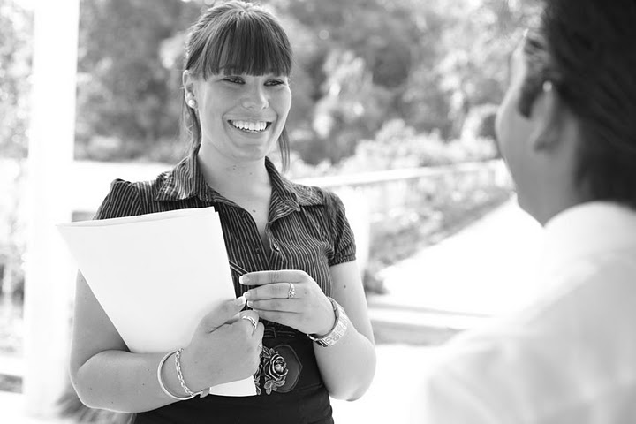
Report queries and results to designated person within enterprise for follow-up
Reporting queries and results is important because:
It is effective market research
It is customer-focused
It always sharing of information
It makes staff accountable for their actions.
If ‘it’ is good for the visitor, it is good for the venue.
Notes:
Trainer stresses to trainees it is important for every tourist venue/destination to be actively involved in monitoring the queries of visitors, and the information provided to visitors by venue staff, because:
This is an effective and inexpensive way of identifying what is important and of interest to our visitors. It is cheap market research
It demonstrates customer focus – meaning the venue can use the research to better create experiences more appropriately suited to identified customer needs, wants and preferences
This is an excellent way of sharing information between staff at the venueabout what to do, and about what not to do, say, suggest and about what is effective and what is not
It makes staff accountable. If employees know their actions and recommendations are gong to be fed back to management they will tend to be more responsible, sensible and focused in what they suggest
Regular meetings of this nature amongst staff and with management help staff maintain a focus on customers and their needs, as opposed to creating a focus on themselves and the venue. The focus must always be on the customers/tourists and what is best for them.
If ‘it’ is good for the visitor, it will ultimately be good for the venue.

Slide 81

Report queries and results to designated person within enterprise for follow-up
People involved in reports are:
Report makers
Report takers.
Regular reporting is essential.
Notes:
Trainer identifies personnel involved in reports are:
Report makers. This includes all customer contact or frontline staff:
Reception/front office staff
Porters and concierge
Waiting staff – food and beverage
Bar staff
Attendants in retail outlets within the property
Tour guides and tour vehicle drivers
Ride attendants
Ushers and Information officers.
Report takers may include:
Owner of the business
Managers
Marketing department
In-house trainers
Safety and security officers.

Slide 82
Report queries and results to designated person within enterprise for follow-up
Reporting options:
Written
Verbal
Combination of both.
Notes:
Trainer identifies to trainees the basic options for providing these reports is:
Written report –which often involves completion of a pro forma document to ensure relevant items are covered, and to speed up the process. The written report may be delivered in hard copy form, or electronically forwarded via the intranet
Verbal report on a face to face basis either one on one or in a group setting such as a staff meeting, briefing or training session
A combination of the verbal and written feedback. This is arguably the most effective and informative but is also the most expensive and time consuming.

Slide 83

Report queries and results to designated person within enterprise for follow-up
Follow-up action may include:
Staff training
Revision to standard materials available
Introducing, changing or removing products and services
Changing venue advertisement
Apologies to customers.
Notes:
Trainer explains the nature of the follow-up required to queries and results will depend on the nature of the issues identified, but possible action may include:
Staff training which could involve:
Learning more venue, product and local knowledge
Learning another language or some simple/useful phrases or words from the language of another country from which lots of visitors come
Learning how to more effectively question and/or listen to people to better identify their needs
Revisions to standard internal training materials and content
Revising the suggestions, recommendations and information to be given to visitors.
Revision to standard materials available at the venue, for example:
Obtaining more or different brochures, flyers, maps, schedules, price lists
Updating materials identified as being out of date. These can be found in displays, behind reception, at the concierge desk and in the room compendiums
Creating materials to meet an identified need where no other materials exist
Introducing, changing or removing products and services:
To better meet identified needs
Notifying sales representatives and commission agents about changes
Promoting the new/revised products, services or packages and inclusions
Changing venue advertisements:
In order to better accommodate/target identified needs, wants and preferences
In terms of online advertisements, brochures for the venue, media advertisements and entries in travel books and with Visitor Information Centres
Apologies to customers which may involve:
Verbal or written apology
A refund or substitute product or service or a discount or special offer for another product or service.
Class Activity – Guest Speaker
Trainer arranges for a suitable management-level person from a venue/attraction to attend and talk to trainees about:
The importance of knowing about visitor needs, wants and preferences
How they identify what their guest/visitor needs, wants and preferences are
How they encourage their frontline staff to report on visitor queries
How they obtain ‘results’ regarding their provision of advice and information to visitors
Action they might take in response to:
Positive outcomes
Negative outcomes.

Slide 84
Summary – Element 3
When maintaining contact with local communities :
Provide information and responses to tourist/visitor queries that are honest, comprehensive, current, relevant and timely
Realise it is everyone’s job to provide local information to visitors/tourists
(Continued)
Notes:
Trainer provides a recap of the Element asking questions to check trainee understanding and responding to questions from trainees, as required.

Slide 85
Summary – Element 3
Create a file for commonly required local information such as information about the venue, local transport, attractions, events, general visitor facilities, dining, shopping, entertainment, weather, local legislation and regulations
Be alert to the possibilities and potential for using local knowledge to promote local tourism products and services
(Continued)
Notes:
Trainer provides a recap of the Element asking questions to check trainee understanding and responding to questions from trainees, as required.

Slide 86
Summary – Element 3
Be proactive in promoting local tourism products and services. Never be shy about promoting what the area/venues have to offer
Recognise the benefits flowing the effective promotion of tourism products and services
Suggest/recommend add-ons and extras at every appropriate opportunity
(Continued)
Notes:
Trainer provides a recap of the Element asking questions to check trainee understanding and responding to questions from trainees, as required.

Slide 87
Summary – Element 3
Sell the benefits of any add-on or extra as well as any physical characteristics that apply
Match what you try to sell as add-ons and extras to identified visitor needs. Talk to them to identify what they want, need or prefer and what, if any, restrictions apply
Never pressure anyone into buying
(Continued)
Notes:
Trainer provides a recap of the Element asking questions to check trainee understanding and responding to questions from trainees, as required.

Slide 88
Summary – Element 3
Provide regular and comprehensive feedback to management and others in the workplace regarding visitor queries and the way in which they have been handled
Strive to continually provide excellent service to customers regarding the way in which their queries are dealt with. Be prepared to take necessary action to address negative situations.
Notes:
Trainer provides a recap of the Element asking questions to check trainee understanding and responding to questions from trainees, as required.
Trainer thanks trainees for their attention and encourages them to apply course content as required in their workplace activities.

